Slide 1
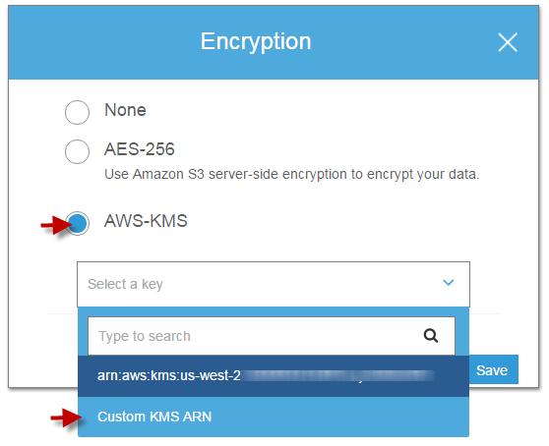
Other services and functions
1. S3- other functions:
Multipart-upload: to increase uploading speed when uploading big files
Encryption (Server side encryption):
2.1 With key from customer (you), headers:
1. x-amz-server-side​-encryption​-customer-algorithm
2. x-amz-server-side​-encryption​-customer-key
3. x-amz-server-side​-encryption​-customer-key-MD5
2.2. With key from KMS (Key management service):
x-amz-server-side-encryption:aws:kms
2.3. With key from S3 (S3-Managed Keys ):
x-amz-server-side-encryption": "AES256“
3. Amazon S3 Transfer Acceleration: leverages Amazon CloudFront’s Edge Locations to increase upload speed (when your uploaders are globally distributed)

Slide 2


Other services and functions
S3(cont)
4. VPC endpoint
5. Versioning: manage many versions of an objects
6. Cross region replication: must enable versioning first
7. Snowball: Transfer Terabyte of Data in AWS quickly (80 TB/each)
8. Snowmobile: a Truck of Snowball (100PB/each)
https://tutorialsdojo.com/aws-cheat-sheet-s3-transfer-acceleration-vs-direct-connect-vs-vpn-vs-snowball-vs-snowmobile/

Slide 3
S3 – Sample questions
A web application is uploading large files, which are over 4 GB in size, to AWS S3 every 30 minutes. You want to minimize the time required to upload each file.
Which of the following should you do to minimize upload time?
A. Use the BatchWriteItem API.
B. Enable Transfer Acceleration in the bucket.
C. ​Use the Multipart upload API.
D. Use the Putltem API.

Slide 4
S3 – Sample questions
A global financial company has hundreds of users from all over the world that regularly upload terabytes of transactional data to a centralized S3 bucket. You noticed that there are some users from different parts of the globe that take a lot of time to upload their data, which causes delays in the processing. You need to improve data throughput and ensure consistently fast data transfer to the S3 bucket regardless of the user's location.
Which of the following features should you use to satisfy the above requirement?
​A. AWS Transfer for SFTP
B. CloudFront
​C. Amazon S3 Transfer Acceleration
D. AWS Direct Connect

Slide 5
Other services and functions
2. DynamoDB
Atomic Counter: You can use the UpdateItem operation to implement an atomic counter — a numeric attribute that is incremented, unconditionally, without interfering with other write requests. (Note: This is not absolutely accurate)
BatchGetItem and BatchWriteItem API operations:decrease operation time
Conditional Write: Check a condition before performing updates
ReturnConsumedCapacity: return a Read/Write capacity unit used by an operation

Slide 6
DynamoDB-Sample question
A developer wants to track the number of visitors on their website, which has a DynamoDB database. This is primarily used to give a rough idea on how many people visit the site whenever they launch a new advertisement, which means it can tolerate a slight overcounting or undercounting of website visitors.
Which of the following will satisfy the requirement with MINIMAL configuration?
​
A. Use conditional writes to update the counter item in the DynamoDB table only if the item has a unique primary key and the new value is greater than the current value.
​
B. Use conditional writes to update the counter item in the DynamoDB table and set the ReturnConsumedCapacity parameter to TOTAL.
​
C. Enable DynamoDB Streams to track the number of new visitors.
​
D. Use atomic counters to increment the counter item in the DynamoDB table for every new visitor.

Slide 7
DynamoDB-Sample question
A commercial bank is developing an online auction application with a DynamoDB database that will allow customers to bid for real estate properties from the comforts of their homes. The application should allow the minimum acceptable price established by the bank prior to the auction. The opening bid entered by the staff must be at least the minimum bid and the new bids submitted by the customers should be greater than the current bid. The application logic has already been implemented but the DynamoDB database calls should also be tailored to meet the requirements.
Which of the following is the MOST effective solution that will satisfy the requirement in this scenario?
​
A. Use an optimistic locking strategy in your database calls to ensure that the new bid submitted by the customer is greater than the current bid.
​
B. Use DynamoDB Streams and a Lambda function to track the current bid price and compare against all of the new bids submitted by the customers.
​
C. Configure the database calls of the application to use conditional updates and conditional writes with a condition expression that will check if the new bid submitted by the customer is greater than the current bid.
​
D. Enable DynamoDB Transactions to automatically check the minimum acceptable price as well as the current and new bid price.

Slide 8
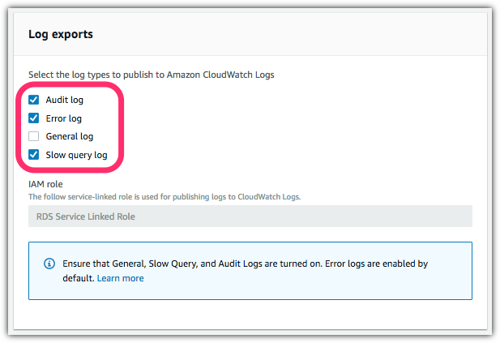
Other services and functions
3. Relational Database Servicec (RDS): AWS-managed service for Relational Databases
Multi-AZ deployment: create backup of your DB in other AZ for active-passive failover
Read Replica: a copy of your DB for Read operations (reduce load for main DB)
Log types: refer to screenshot

Slide 9
RDS – Sample Question
1. There has been reports that your application, which has a MySQL RDS database, becomes unresponsive from time to time. You were instructed to collect all SQL statements that took longer to execute for troubleshooting.
What should you do to properly troubleshoot this issue with the LEAST amount of effort?
​A. Use Amazon Inspector to get all the slow queries.
​B. Enable slow query log in RDS.
​C. Enable active tracing using AWS X-Ray.
​D. Instrument your application using the X-Ray SDK.

Slide 10
Other services and functions
4. ElastiCache
Memcache vs Redis
Simple data Complex Query
Multi-thread No Multi-thread
No Fail-over Fail-over (multi AZ, backup nodes)
Cache techniques:
Lazy-loading: only cache after that piece of data is requested
Write-through: cache all data

Slide 11
ElastiCache Question
1. A developer is building a web application which requires a multithreaded event-based key/value cache store that will cache result sets from database calls. You need to run large nodes with multiple cores for your cache layer and it should scale up or down as the demand on your system increases and decreases.
Which of the following is the MOST suitable service that you should use?
​A. AWS Greengrass
​B. Amazon ElastiCache for Memcached
C. Amazon CloudFront
​D. Amazon ElastiCache for Redis
2. A developer is moving a legacy web application from their on-premises data center to AWS. The application is concurrently used by thousands of people and it stores the user session state in memory. Its on-premises server usually reaches 100% CPU Utilization every time there is a surge on the number of people accessing the application.
Which of the following is the best way to re-factor the performance and availability of the application's session management once it is migrated to AWS?
​A. Use an ElastiCache for Memcached cluster to store the user session state of the application.
B. Store the user session state of the application using CloudFront.
​C. Use Sticky Sessions with Local Session Caching.
​D. Use an ElastiCache for Redis cluster to store the user session state of the application.

Slide 12
ElastiCache Question
3. An application is hosted in an Amazon ECS Cluster which uses an RDS database. You noticed that the application performance slows down whenever there is a surge in requests that use the same SQL read queries. This has prompted you to optimize the queries of your application to improve performance, however, the problem still persists even after applying the change.
Which of the following can you do to resolve this performance issue? (Select TWO)
A. ​Implement a Multi-AZ deployments configuration in your RDS database.
B. ​Implement database caching using CloudFront.
C. ​Create Read Replicas.
D. Refactor your application to use Redshift database instead.
E. ​Implement database caching using ElastiCache.

Slide 13
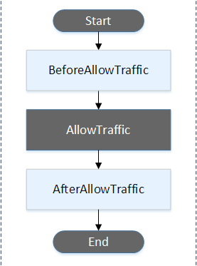
Other services and functions
5. CodeDeploy:
Event Hook: wait for an event before performing an action (run scripts/tasks….)
A developer is preparing the application specification (AppSpec) file in CodeDeploy, which will be used to deploy her Lambda functions to AWS. In the deployment, she needs to configure CodeDeploy to run a task before the traffic is shifted to the deployed Lambda function version.
Which deployment lifecycle event should she configure in this scenario?
​A. Install
​B. BeforeAllowTraffic
C. BeforeInstall
​D. Start

Slide 14
Other services and functions Direct Connect
5.Direct Connect: setup a private connection from your datacenter to AWS, with lower ping and high bandwidth (1GBs-10GBs)
*Private: not exposed/routed through the Internet
- Direct Connect vs VPN: both are private connection, but VPN doesn’t increase network quality
You are working as a Systems Administrator for a medical device manufacturer which has recently adopted a hybrid cloud infrastructure. They need to establish a dedicated connection between their on-premises network and their AWS VPC. In the next couple of weeks, they will migrate their applications and move their data from their on-premises network to AWS, which is why they need a more consistent network experience than Internet-based connections.
Which of the following options would you implement for this scenario?
​
A. Set up a VPN Connection
B. ​Set up a Direct Connect connection
C. Set up a VPC peering
D. ​Set up an AWS VPN CloudHub

Slide 15
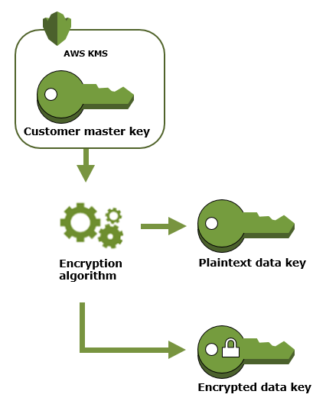
Other services and functions Key management Service (KMS)
6. Key management Service: Provide key for you or store your key for encryption
- A Master key: to enrypt/decrypt data key (max 4KB)
A Data Key:
1. Encrypted data key: to store together with your encrypted data
2. Plaintext data key: to encrypt/decrypt your data
Question:
You are building a distributed system using KMS where you need to encrypt data at a later time. An API must be called that returns only the encrypted copy of the data key which you will use for encryption. After an hour, you will decrypt the data key by calling the Decrypt API then using the returned plaintext data key to finally encrypt the data.
Which is the MOST suitable KMS API that the system should use to securely implement the requirements described above?
​
A. GenerateDataKey
​B. GenerateDataKeyWithoutPlaintext
C. GenerateRandom
D. ​Encrypt

Slide 16
Other services and functions Cloud Hardware Security Module (CloudHMS)
7. Cloud Hardware Security Module (CloudHMS)
A Hardware Security Module provided by AWS to store encryption keys
Question
A cryptocurrency exchange portal has a key management service hosted in their on-premises data center, which stores encryption keys and uses an RSA asymmetric encryption algorithm. The company has recently implemented a hybrid cloud architecture in AWS and you were assigned to migrate the exchange portal to their cloud infrastructure. For security compliance, the keys should be stored in dedicated, third-party validated hardware security modules under your exclusive control.
Which of the following is the BEST solution that you should implement to meet the above requirement?
​A. Import the encryption keys from your on-premises key management service to AWS KMS as Customer Master Keys (CMKs).
B. ​Develop a custom key management service using the AWS Encryption SDK.
C. ​Use AWS KMS to store and manage the encryption keys.
D. ​Import the encryption keys from your on-premises key management service to AWS CloudHSM.

Slide 17
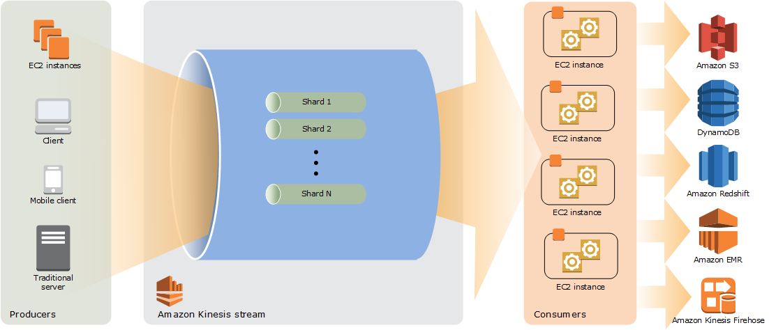
Other services and functions Kinesis Data Stream
8. Kinesis Data Stream: to stream data/log into a consumer in AWS
Data flow is split into shards.
Each shard can only be process by only 1 EC2 instance
Question:
Your application is processing one Kinesis data stream which has four shards, and each instance has one KCL worker. To scale up processing in your application, you reshard your stream to increase the number of open shards to six.
What is the MAXIMUM number of EC2 instances that you should launch to achieve optimum performance?
​A.3
​B. 5
​C. 6
D. 12

Slide 18
Other services and functions AWS Secrets Manager
9. AWS Secrets Manager: store confidential information (database credentials, license key…) and encrypt them with a encryption key
It will also manage rotation of the encryption key for you.
Question:
An e-commerce application, which is hosted in an ECS Cluster, contains the connection string of an external database and other sensitive configuration files. Since the application accepts credit card payments, the company has to meet strict security compliance which requires that the database credentials are encrypted and periodically rotated.
Which of the following should you do to comply to the requirements?
​
A. Store the database credentials in AWS Secrets Manager and enable rotation.
B. Store the database credentials in an encrypted ecs.config configuration file.
C. ​Store the database credentials in an encrypted dockerrun.aws.json configuration file.
D. ​Store the database credentials as a secure string parameter in Systems Manager Parameter Store.

Slide 19
Other services and functions AWS Parameter Store
9. Parameter Store: encrypt and store configuration data and secure strings in hierarchies and track versions.
(first 2000 parameters are free)
Question:
A serverless application is composed of several Lambda functions which reads data from RDS. These functions must share the same connection string to connect to the DB.
Which of the following is the MOST secure way to meet the above requirement?
A. Use AWS Lambda environment variables encrypted with CloudHSM.
B. Create a Secure String Parameter using the AWS Systems Manager Parameter Store.
C. Create an IAM Execution Role that has access to RDS and attach it to the Lambda functions.
D. Use AWS Lambda environment variables encrypted with KMS which will be shared by the Lambda functions.

Slide 20
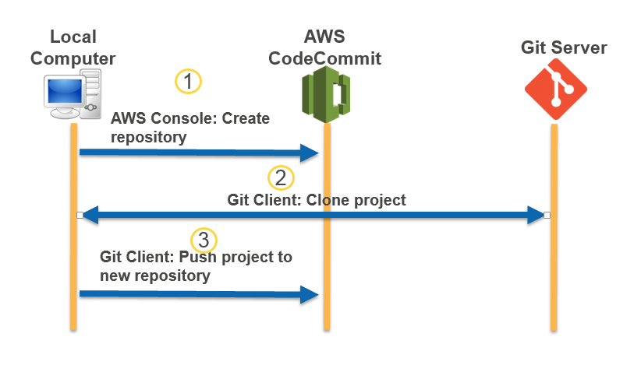
Other services and functions AWS Code Commit
10. Code Commit : A code version control Service similar to Github
You are working for a startup which recently decided to host their web applications to AWS. All of the source code of their applications are hosted in Github and they are planning to migrate them all to CodeCommit.
Which of the following BEST describes the process of migrating an existing Git repository to a CodeCommit repository?
​
A.Create a new Git repository. Clone your existing CodeCommit repository and then push its contents to the newly created Git repository.
B.​Create a new Git repository. Clone your existing CodeCommit repository and then pull its contents to the newly created Git repository.
C.Create a new CodeCommit repository. Clone your existing Git repository and then pull its contents to the newly created CodeCommit repository.
D.​Create a new CodeCommit repository. Clone your existing Git repository and then push its contents to the newly created CodeCommit repository.

